Slide 1
Introduction to Computers
Course Teacher:
Nazmun Nessa Moon
Assistant Professor

Slide 2
Learning Objectives
In this lecture you will learn about:
Computer
Data processing
Characteristic features of computers
Computers’ evolution to their present form
Computer generations
Characteristic features of each computer generation

Slide 3
Computer
The word computer comes from the word “compute”, which means, “to calculate”
Thereby, a computer is an electronic device that can perform arithmetic operations at high speed
A computer is also called a data processor because it can store, process, and retrieve data whenever desired

Slide 4
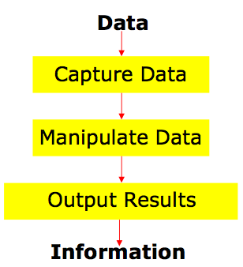
Data Processing
The activity of processing data using a computer is called data processing
Data is raw material used as input and information is processed data obtained as output of data processing

Slide 5
Characteristics of Computers
Automatic: Given a job, computer can work on it automatically without human interventions
Speed: Computer can perform data processing jobs very fast, usually measured in microseconds (10⁻⁶), nanoseconds (10⁻⁹), and picoseconds (10⁻¹²)
Accuracy: Accuracy of a computer is consistently high and the degree of its accuracy depends upon its design. Computer errors caused due to incorrect input data or unreliable programs are often referred to as Garbage-In-Garbage-Out (GIGO)
Diligence: Computer is free from monotony, tiredness, and lack of concentration. It can continuously work for hours without creating any error and without grumbling

Slide 6
Characteristics of Computers
Versatility: Computer is capable of performing almost any task, if the task can be reduced to a finite series of logical steps
Power of Remembering: Computer can store and recall any amount of information because of its secondary storage capability. It forgets or looses certain information only when it is asked to do so
No I.Q.: A computer does only what it is programmed to do. It cannot take its own decision in this regard
No Feelings: Computers are devoid of emotions. Their judgment is based on the instructions given to them in the form of programs that are written by us (human beings)

Slide 7
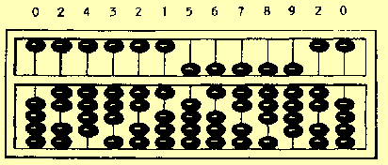
Evolution of Computers
The abacus is a manually operated digital computer used in ancient civilizations
The use of the word abacus dates before 1387 AD

Slide 8
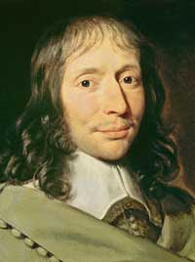
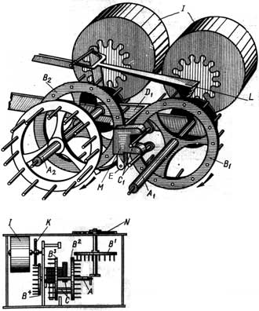
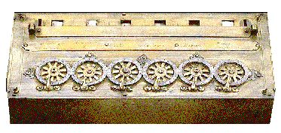
Evolution of Computers
The first mechanical adding machine (calculator) was invented by Blaise Pascal (French) in 1642

Slide 9
Evolution of Computers
Baron Gottfried Wilhelm von Leibniz invented the first calculator for multiplication in 1671
Keyboard machines originated in the United States around 1880
Around 1880, Herman Hollerith came up with the concept of punched cards that were extensively used as input media until late 1970s

Slide 10
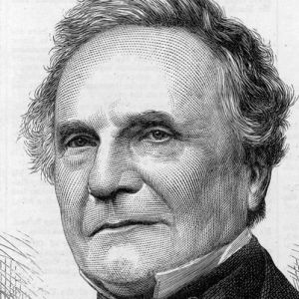
Evolution of Computers
Charles Babbage is considered to be the father of modern digital computers
He is best remembered now for originating the concept of a programmable computer
He designed “Difference Engine” in 1822
He designed a fully automatic analytical engine in 1842 for performing basic arithmetic functions
His efforts established a number of principles that are fundamental to the design of any digital computer

Slide 11
Some Well Known Early Computers
The Mark I Computer (1937-44)
The Atanasoff-Berry Computer (1939-42)
The ENIAC (1943-46)
The EDVAC (1946-52)
The EDSAC (1947-49)
Manchester Mark I (1948)
The UNIVAC I (1951)

Slide 12
Computer Generations
“Generation” in computer talk is a step in technology. It provides a framework for the growth of computer industry
Originally it was used to distinguish between various hardware technologies, but now it has been extended to include both hardware and software
Till today, there are five computer generations

Slide 13
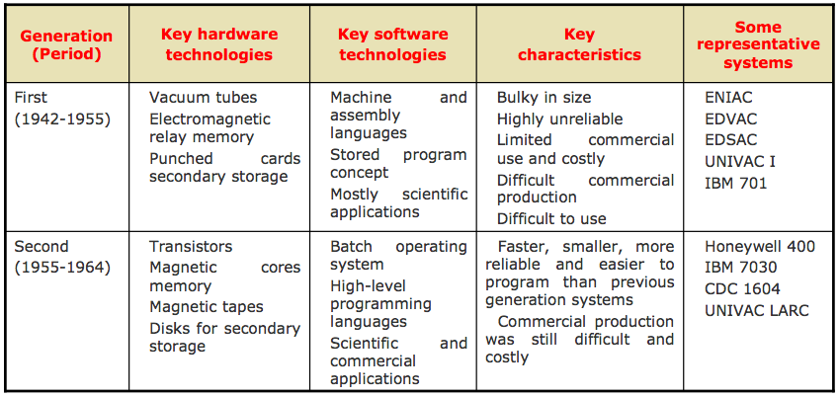
Computer Generations

Slide 14
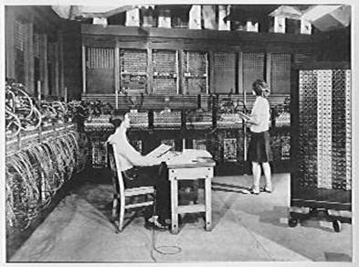
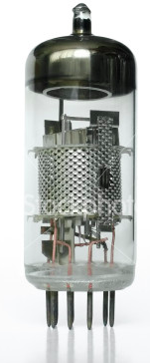
1st Generation Computer
Vacuum tube based
Vacuum tube

Slide 15
Computer Generations

Slide 16
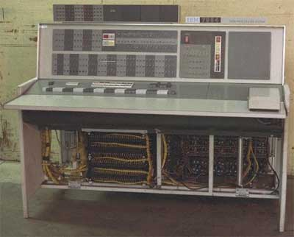
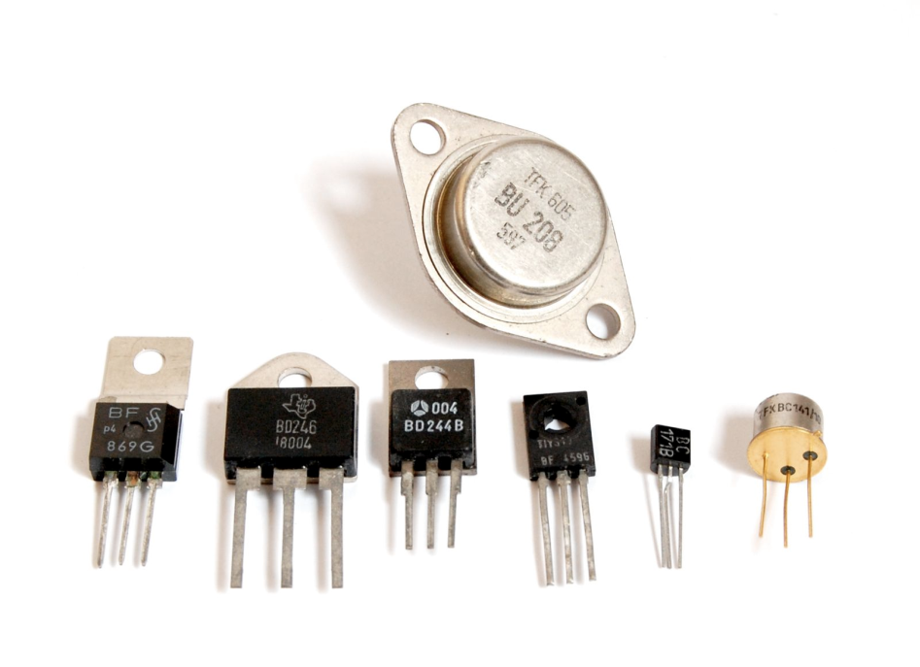
2nd Generation Computer
Transistor
Transistor based.

Slide 17
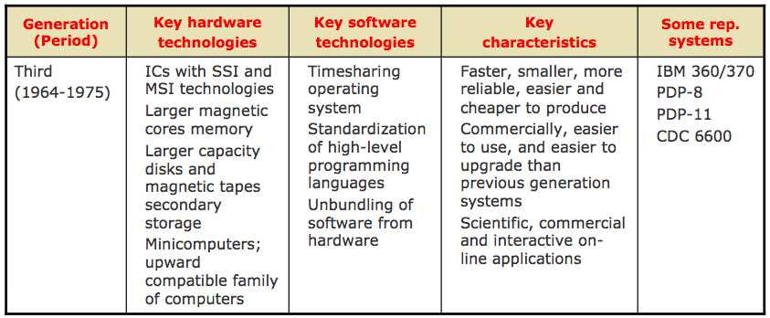
Computer Generations

Slide 18
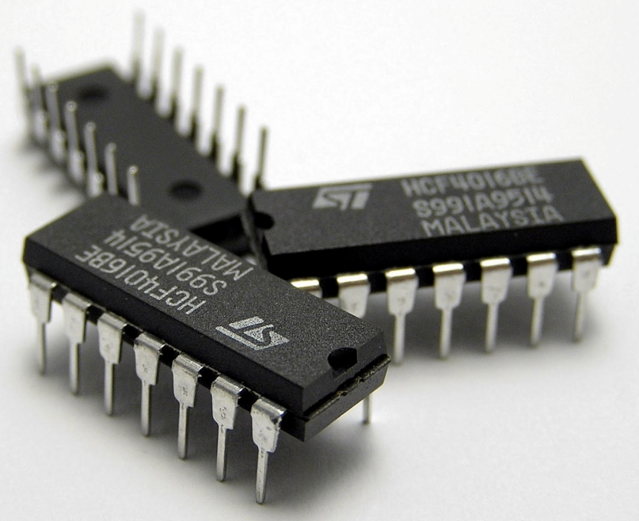
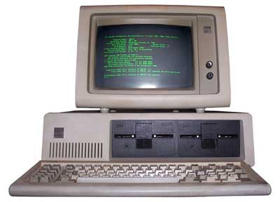
3rd Generation Computer
IC

Slide 19
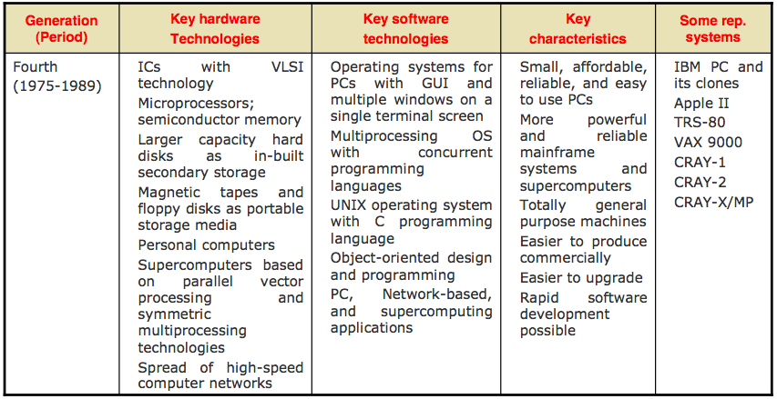
Computer Generations

Slide 20
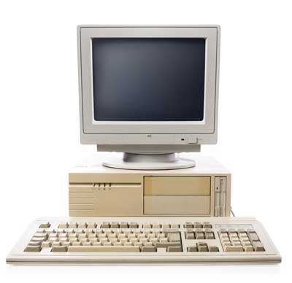
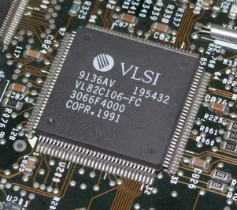
4th Generation Computer

Slide 21
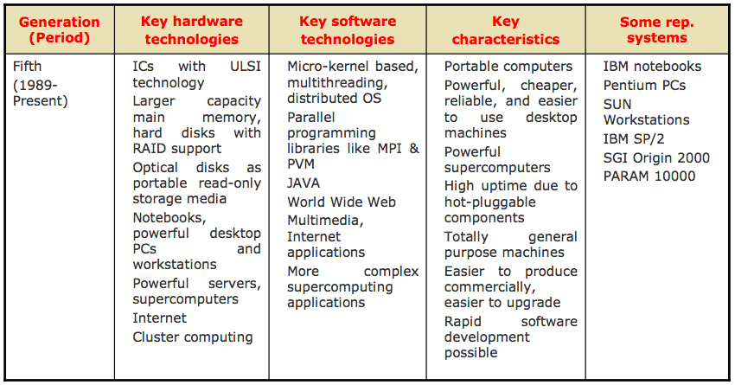
Computer Generations

Slide 22
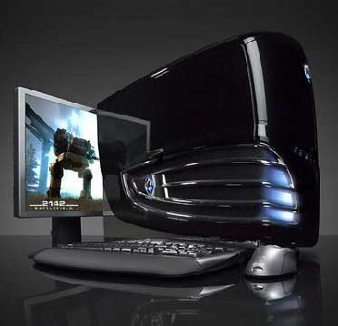
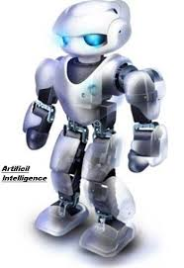
5th Generation Computer

Slide 23
Key Words/Phrases
Computer Integrated Circuit (IC)
Computer generations Large Scale Integration (VLSI)
Computer Supported Cooperative Working (CSCW) Medium Scale Integration (MSI)
Microprocessor Data
Personal Computer (PC) Data processing
Second-generation computers Data processor
Small Scale Integration (SSI) First-generation computers
Stored program concept Fourth-generation computers
Third-generation computers Garbage-in-garbage-out (GIGO)
Transistor Graphical User Interface (GUI)
Ultra Large Scale Integration (ULSI) Groupware
Information Vacuum tubes

